Slide 1

Code Mastery: Plugin Development for ASP.NET Web Applications Hassan Nasrollahzadeh
August 1, 2017
Notes:
If your system doesn’t have the CORDIA NEW font, please use “Title Slide (Alt)”

Slide 2

Agenda
About me:
Principal Consultant with 15 years of professional programming experience
Building custom software on the Microsoft Technology Stack
Intro
Demo
The plugin structure, output, and required files
Handling requests. Controllers, models and views
Q/A
Contact Info

Slide 3
Agenda
Intro
A Plugin is a set of components that adds particular capabilities to an existing software application.
When an application supports plug-ins, it enables customization
Motivation
Why plugin
to enable third-party developers to create abilities which extend an application
to support easily adding new features
to reduce the size of an application
Examples
Payment methods
Shipping rates
Search engines

Slide 4
Demonstration
A demo and walkthrough of Pluggable modular/layered architecture which allows additional functionality and presentation elements (Plugins) to be dynamically added to the application at runtime.

Slide 5
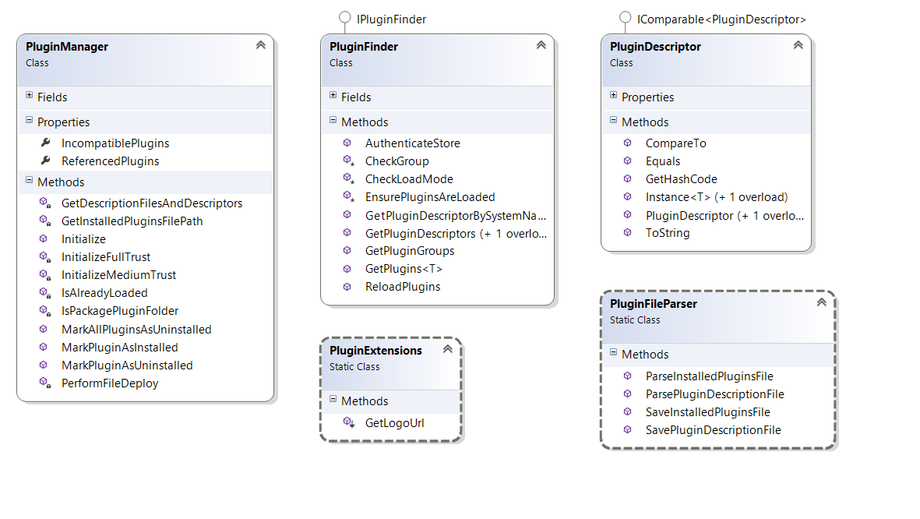
Plugin Core

Slide 6
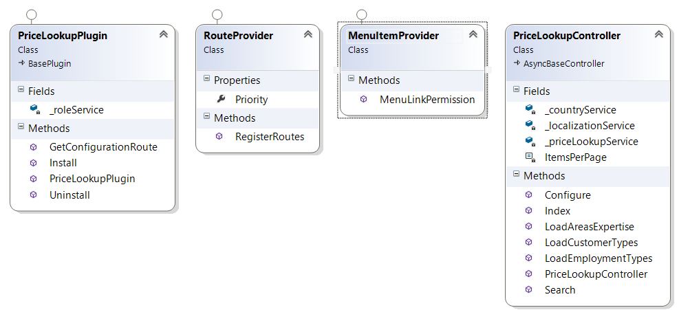
Plugin files

Slide 7
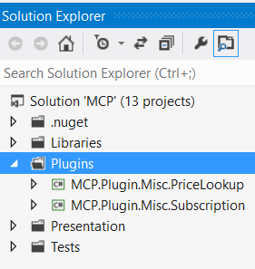
The plugin structure
piece
A class library will include the piece of functionality that you would like to add as plugin to your web application. Create a new "Class Library" project in the solution. It's a good practice to place all plugins into \Plugins directory in the root of your solution (do not mix up with \Plugins subdirectory located in \Web directory which is used for already deployed plugins).

Slide 8
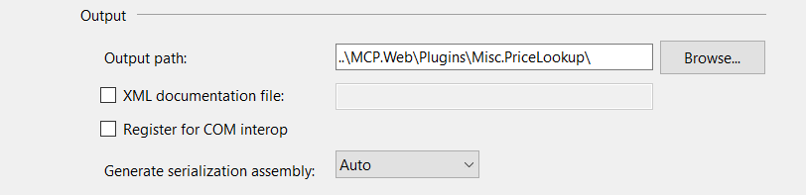
Output
Once the plugin project is created update the project build output path. Set it to "..\..\Presentation\MCP.Web\Plugins\{Group}.{Name}\".

Slide 9
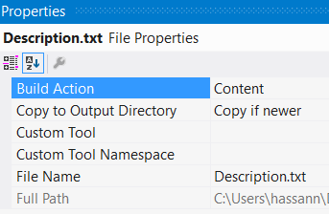
Required files
Creation of Description.txt file is required for each plugin. This file contains meta information describing your plugin. For example, a price lookup plugin has the following Description.txt file:
Group: Misc
FriendlyName: Price Lookup
SystemName: Misc.PriceLookup
Version: 1.0
SupportedVersions: 3.60
Author: MCP team
DisplayOrder: 1
FileName: MCSR.Plugin.Misc.PriceLookup.dll
Ensure that "Copy to Output Directory" property of this file is set to "Copy if newer".

Slide 10
Required files and structure
A web.config file should be created and ensure that it's copied to output. This could be copied from the standard web application web.config
Make sure "Copy local" properties of all third-party assembly references are set to "False" (do not copy)
The last required step is to create a class which implements IPlugin interface. BasePlugin class which already implements some IPlugin methods and allows you to avoid source code duplication.

Slide 11
Handling requests. Controllers, models and views
Plugin Controller in the main Web application
Prepare plugin model
List all available plugins
Actions for Install / Uninstall selected plugin
IPlugin Interface Implementation and abstract BasePlugin class
IMenuProvider
Views

Slide 12
Routes
Now we need to register appropriate plugin routes. ASP.NET routing is responsible for mapping incoming browser requests to particular MVC controller actions. So follow the next steps:
Some of the specific plugin interfaces (described above) and the "IMiscPlugin" interface have the following method: "GetConfigurationRoute". It should return a route to a controller action which is used for plugin configuration.
(optional) If you need to add some custom route, then create RouteProvider.cs file

Slide 13
Question / Answer

Slide 14
Contact Info:
Name: Hassan Nasrollahzadeh
Email: hassann@magenic.com
Thank you !

